Slide 1
Data analysis

Slide 2
PROJECT DESCRIPTION
This data set provides a comprehensive overview of the COVID-19 pandemic which occurs on the 30th june, 2024.
This datatset provides a comprehensive view of the COVID-19 pandemic, with detailed information on 238 Countries listings. It covers key attributes such as number of Cases, Deaths, Population, Recovered and Test for each of the country.

Slide 3
questions
What continent has the highest case of COVID-19 on 6/30/2024?
What continent has the highest average death rate that occurred due to the COVID-19?
Which of the continent have the highest and lowest population from the dataset.
What is the continent with the highest number of people that recovered from COVID-19?w
What is the average death rate of each of the country?

Slide 4
Data design
To answer the questions above:
I studied a comprehensive view of the COVID-19 dataset, the key attributes such as Country, Continent, Population, Date Cases, Deaths, Recovered and Test of COVID-19.
The original dataset was cleaned with Excel google sheet, PowerBI and Python.

Slide 5
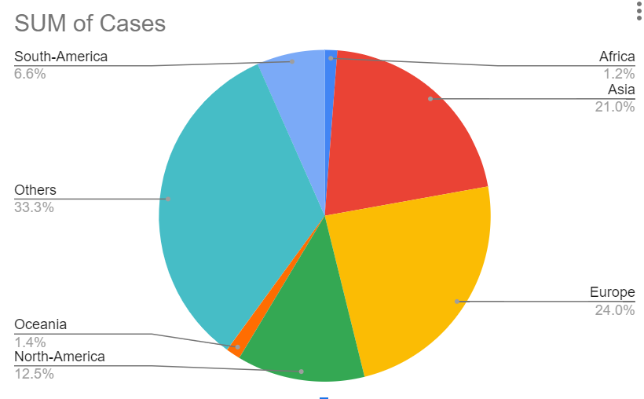
Findings and insight
Q1. Visualization

Slide 6
The visualization in Fig 1.0 above shows the continent with the highest cases of COVID-19 where ALL (Unspecified continent) has he highest case of COVID-19 with 704,754,611(33.3%), followed by Europe with 506,812,396(24.0%) while the lowest case was observed in Africa with 25,721,848(1.2%) cases of COVID-19.

Slide 7
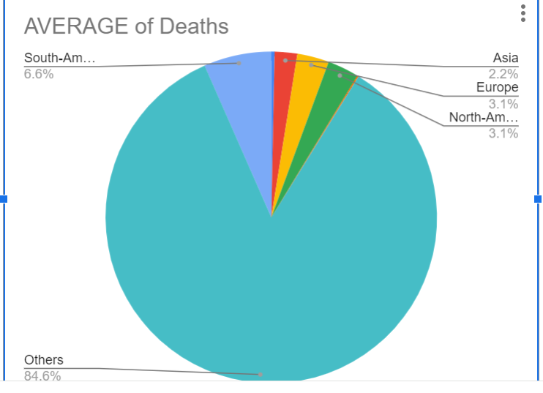
Q2.

Slide 8
The visualization in Fig 2.0 above shows the continent with the highest average death rate where South America is observed as the specified continent with the highest average death rate of about 182,310.93 (6.6%) while Africa has the lowest average death rate 8,776.00(0.3%).
85,788.73
85,788.73

Slide 9
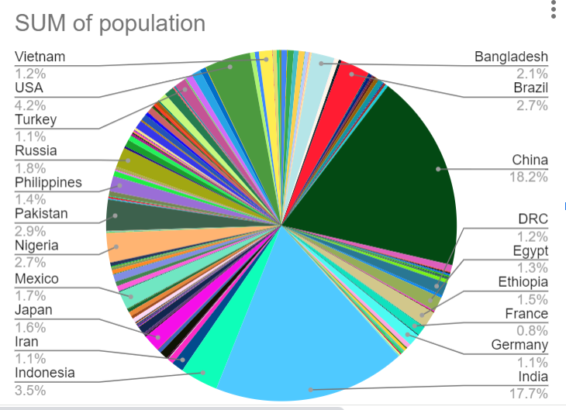
Q3.

Slide 10
The visualization in Fig 3 above shows the country with the highest population where china with 1,448,471,400.00(18.2%).

Slide 11
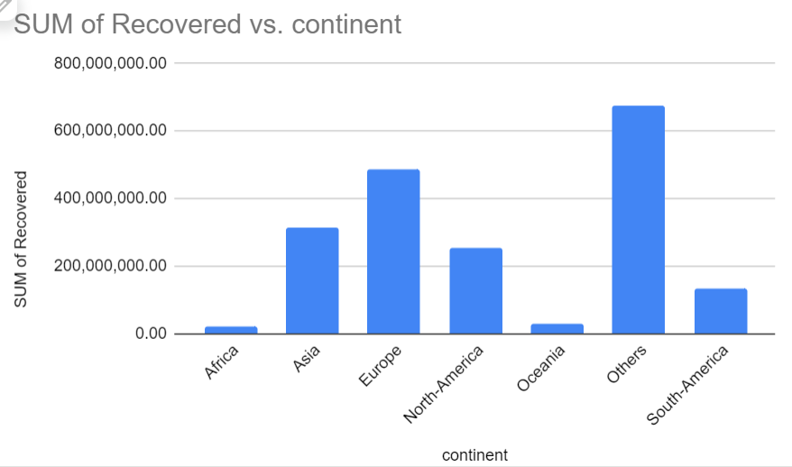
Q4.

Slide 12
The visualization in Fig 4.0 above shows the continent with the highest recovery rate from the COVID-19 pandemic where Europe been a specified continent aside from the unspecified continent(Others) has the highest recovery rate of 484,551,278.00 and Africa is the least continent with 21,302,322.00 recovery rate.

Slide 13
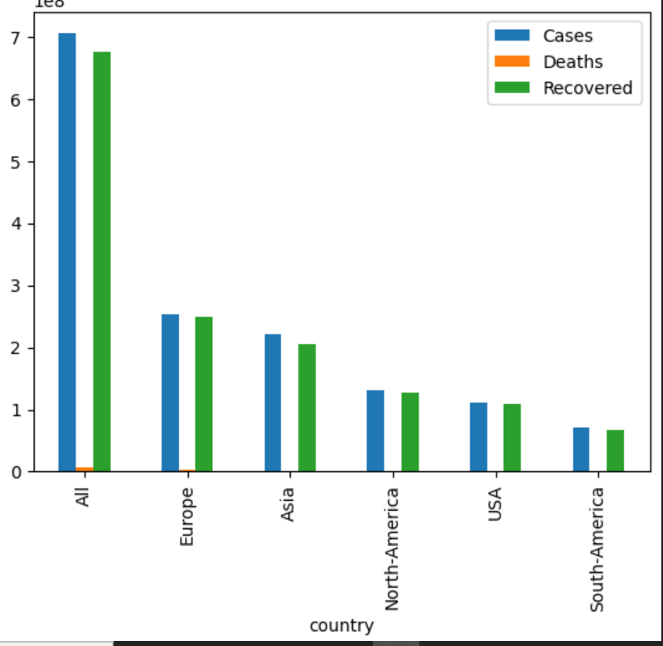
Q5.

Slide 14
The visualization in Fig 5.0 above shows the continent with the highest number of cases, deaths and recovery where Europe happens to top the list.

Slide 15
RECOMMENDATIONS
Vaccination: Encourage mass vaccination programs, prioritizing high-risk groups and essential workers.
Social Distancing: Maintain physical distancing (at least 2 meters) in public, and reduce capacity in enclosed spaces.
Testing and Contact Testing: Scale up testing, contact tracing and isolation of infected individuals.
By implementing these recommendations, the continent can work towards reducing the spread of COVID-19, alleviating the burden on healthcare systems, and mitigating the socio-economic impact of the pandemic.

